Slide 1
10b51 - StockPlan
E*Trade
Abhijeet 30/01/2026

Slide 2
Stock Plan Overview
Understanding Employee Equity Trading Controls
What is a Stock Plan?
Stock plans represent company securities granted to employees by their employer as part of compensation.
Why Restrictions Apply?
Employee trading is governed by regulatory and company compliance requirements and requires prior approval from the Stock Plan Admin
All trades must be planned and submitted in advance before execution.
Key Controls Enforced
Pre-approval of trading plans
Defined waiting (cooling-off) periods
Compliance checks before execution

Slide 3
Rule 10b5-1 Overview
Preventing Insider Trading Through Pre-Planned Trades
Buy or sell securities while aware of material, non-public information (MNPI)
Trade in breach of a duty of trust or confidence
Act with intent to defraud
Engage in reckless disregard of securities laws
Use MNPI to gain an unfair trading advantage

Slide 4
Admin View – Plan Governance
Plan Governance, Compliance, and Oversight
Define and manage plan packages for employees
Assign and maintain custom plan packages per participant
Update or retire existing plan packages
Approve or reject employee-submitted plans based on compliance checks
Access reports and compliance summaries
Execute trades on behalf of employees when requested

Slide 5
Participant View – Plan Execution
Plan Creation and Execution Capabilities
Create custom buy/sell plans for securities
Submit custom plans to Admin for approval
Modify submitted plans (before execution)
Plan execution starts after a 30-day waiting period (Waiting period configurable by Admin)
Track plan status and approval history
View execution details and transaction history

Slide 6
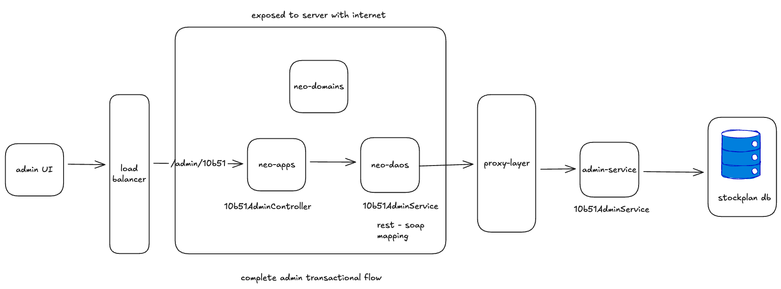
Admin Flow

Slide 7
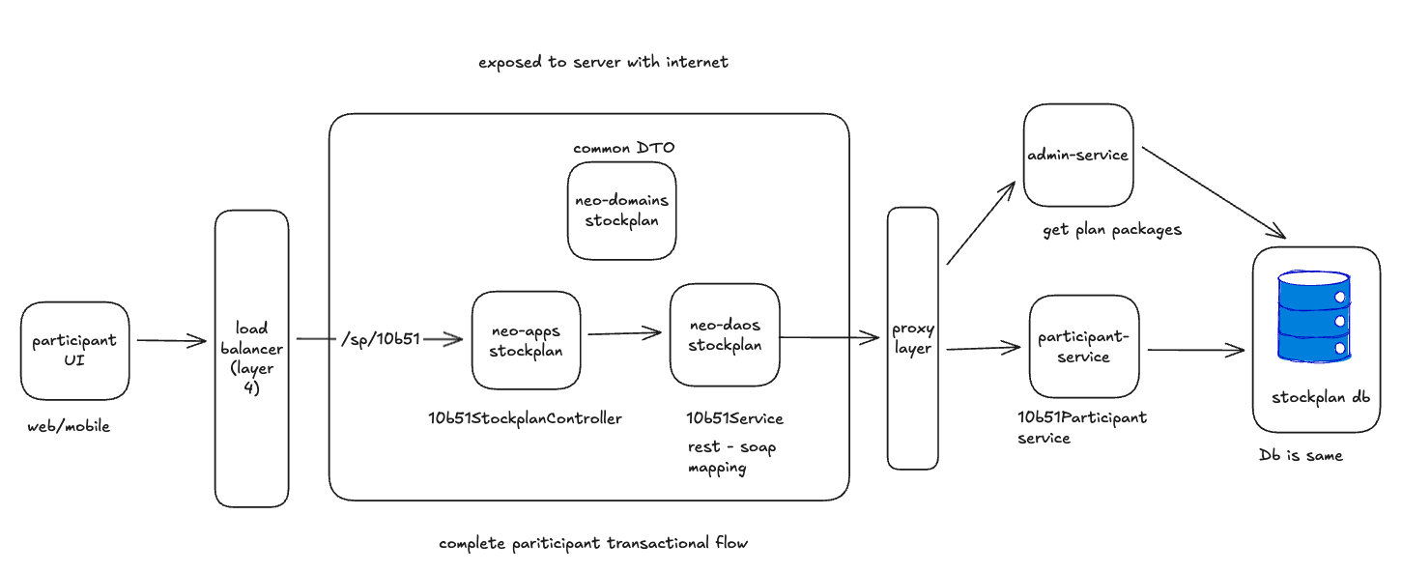
Participant Flow

Slide 8
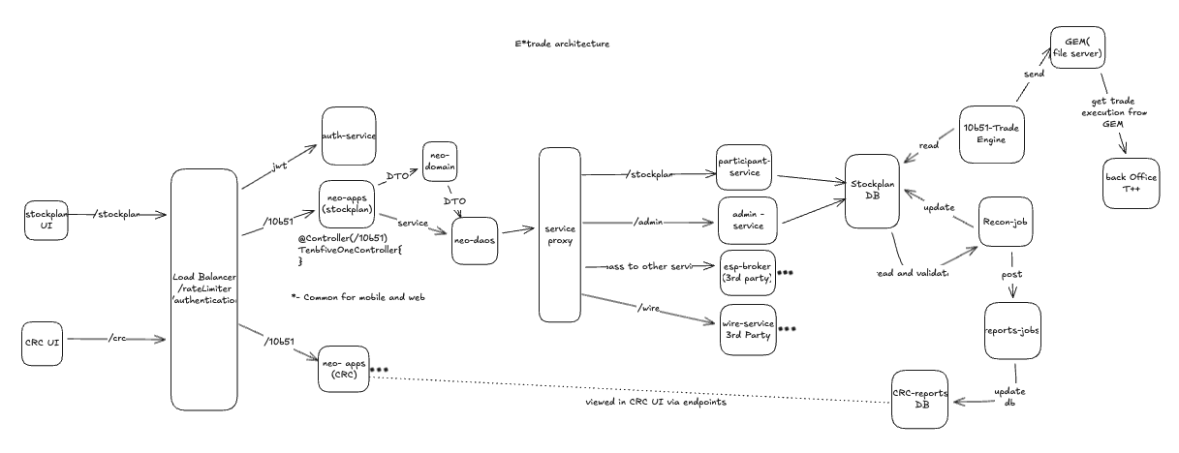
Complete Architecture

Slide 9

Thank You

